Slide 1
Spring 2024

Slide 2
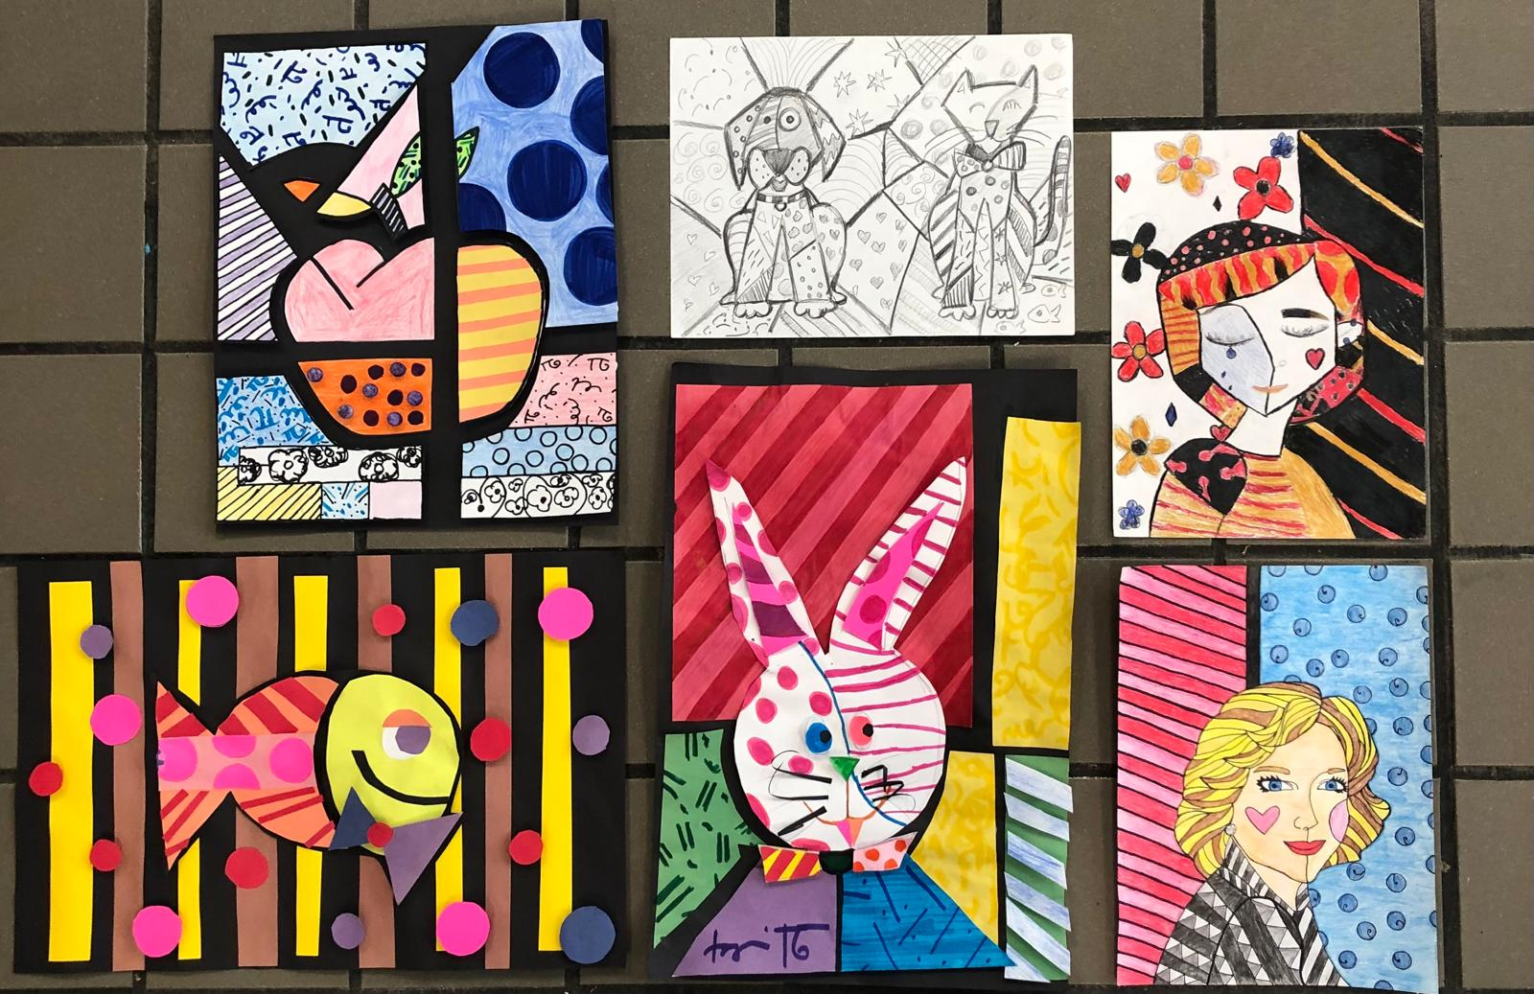

Slide 3
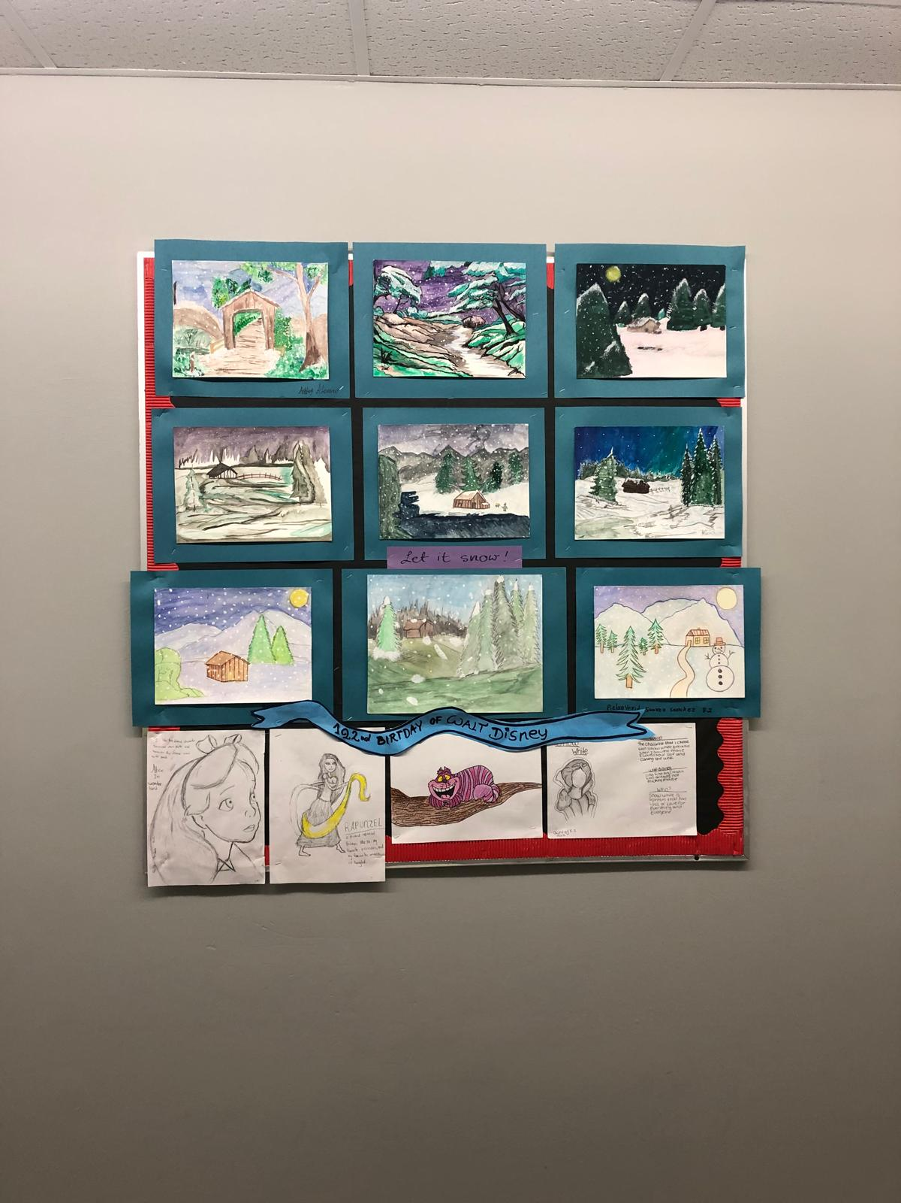

Slide 4
