Slide 1
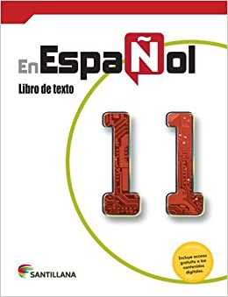
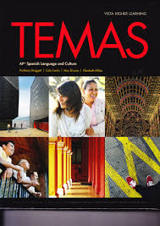
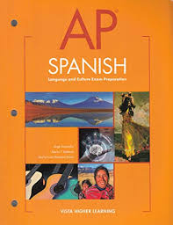
Señora Ubillus
As your child’s teacher, my goal is to have them perform at the highest level of their potential
Email: mariubillus@paps.net
Contact Hours/Horas de contacto: 8:51-9:35 AM

Slide 2
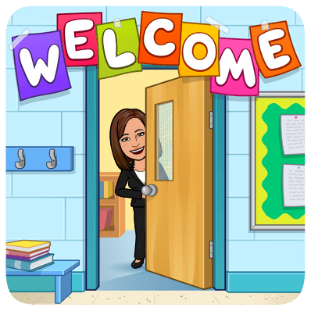
Agenda
Welcome/Bienvenida
Getting to know the teacher/Conociendo a la profesora
Classroom procedures and rules/Procedimiento y reglas de la clase
Grading policy/Grados
Absences and makeup work/Ausencia y trabajo pendiente
Course description and textbook/Descripción del curso y libros
Questions/ Preguntas

Slide 3
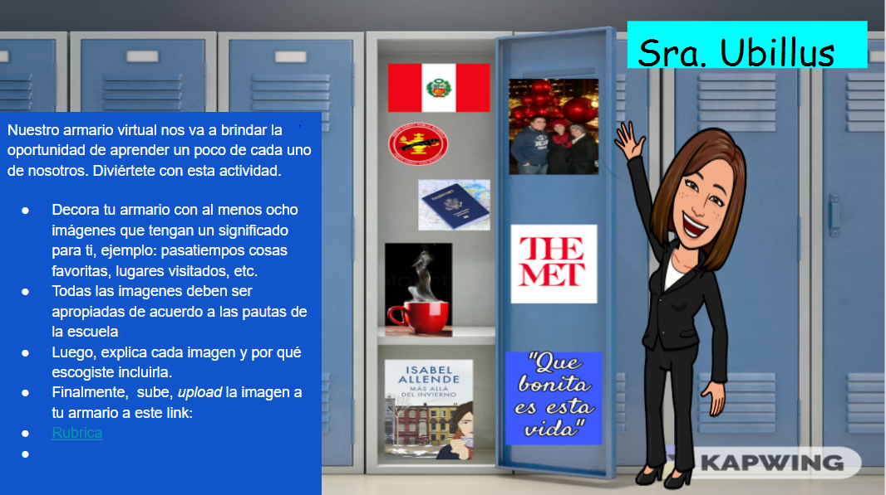
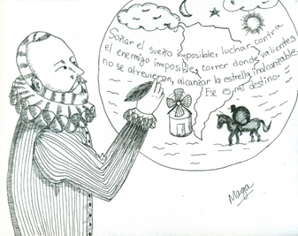

Slide 4
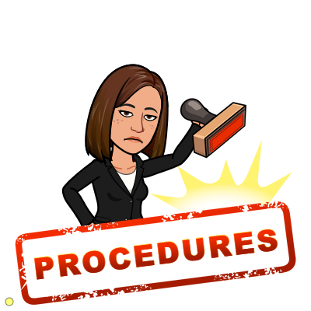
Classroom Procedures
1. Be on time.
2. Silence your microphone and turn on your camera.
3. Find a calm and quiet spot to work.
4. Participate, if you have questions: use the chat or use the icon raise your hand and wait for the teacher to respond.
5. Pay attention when the teacher is talking.
6. Be prepare with your materials: computer charged, notebook, pen or pencil
7. Do not eat during the class.
8. Be respectful all the time
9. Remain in the Google Meet until the teacher dismisses the class.

Slide 5
Reglas de la clase - Classroom Rules
1. Siga las indicaciones de la profesora con prontitud.
Respond promptly to directions given by the teacher.
2. Abstente de distraer o molestar a tus compañeros.
Refrain from disrupting or distracting others during class.
3. Sé respetuoso todo el tiempo. Haz comentarios positivos.
Be respectful at all times. Positive comments only.
4. Obedece todas las reglas de la escuela.
Obey all school rules*

Slide 6
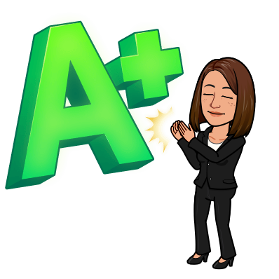
Grades
Your progress in the four skills of speaking, reading, writing, and listening comprehension, in the target language, will be monitored and assessed.
School policy:
60% formal and informal assessments: tests, quizzes, projects,
35% informal assessment: class activities and class participation
5% homework
Note: In order to earn an “A” for class participation you must: speak Spanish most of the time (Spanish III), be with your camera on all the time, complete assignments effectively and efficiently, work cooperatively with the teacher and classmates and follow all classroom rules and procedures.

Slide 7
Absences and Makeup Work
You are responsible for making up any work or test you missed and look over the assignments. Please ask me if there is anything you do not understand about the lessons covered during your absence.

Slide 8
AP - Spanish Language and Culture
Course Overview
The AP Spanish Language and Culture course is a rigorous course taught exclusively in Spanish that requires students to improve their proficiency across the three modes of communication. The course focuses on the integration of authentic resources including online print, audio, and audiovisual resources, as well as traditional print resources that include literature, essays, and magazine and newspaper articles with the goal of providing a rich, diverse learning experience. Students communicate using rich, advanced vocabulary and linguistic structures as they build proficiency in all modes of communication toward the pre-advanced level.

Slide 9
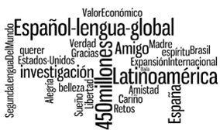
AP - Spanish Language and Culture-Organization
The course is divided into thematic units which are further based on recommended contexts and guided by essential questions. Corresponding cultural elements are integrated into the study of the units, and activities are directed with those cultural connections in mind. Discussion of the topics completely in Spanish is a requirement for this course.
Temas:
El individuo y su identidad
Los efectos de la tecnología
El valor de la familia y la comunidad
¿Cómo se define la belleza?
Nosotros y nuestro mundo
¿Quiénes somos y cómo es nuestra vida?

Slide 10
Spanish III - Course description
This course continues with emphasis on the active learning of the Spanish language through the three modes of communication (interpretive, interpersonal and presentational) as specified in the New Jersey Student Learning Standards for World Language. A variety of exercises and activities are designed to help the student to gain greater proficient in the five basic skills in the language: understanding, speaking, reading, writing and culture. Through the study of the Spanish language all students will make connections with other content areas, compare the Spanish language and culture studied with their own, and participate in home and global communities.

Slide 11
Spanish III - Organization
Themes:
Getting to know you, people, family and myself
Between friends, social life communication
Your things, everyday activities
Healthy leaving
Professions
Hobbies, free time and traveling
Environment

Slide 12
Heritage Spanish III - Course Description
This course continues with emphasis on the active learning of the Heritage Spanish language program through the three modes of communication (interpretive, interpersonal and presentational) as specified in the New Jersey Student Learning Standards for World Language. A variety of exercises and activities are designed to help the student to gain greater proficiency in the five basic skills in the language: understanding, speaking, reading, writing and culture. Through the study of the Heritage Spanish language program, all students will make connections with other content areas, compare the Heritage Spanish language program and culture studied with their own, and participate in home and global communities.

Slide 13
Spanish Literature I - Course description
The curriculum was created for the purpose of addressing native language instruction as a bridge to develop language and cultural literacy in the native language. Consequently, this will create an environment in which students’ background knowledge and personal experiences are valued and utilized, leading to a differentiated quality instruction based on students’ needs.
Spanish Literature I is designed to support students and one of its goals is to further develop student college readiness by integrating literacy. Students have the opportunity to develop and utilize a variety of higher order skills that will enable them to achieve a greater proficiency in their native language and across all content areas. The Spanish Literature I format offers language instruction that will result in effective an Spanish native speaker program of instruction while students are becoming proficient in learning academic Spanish Language. It is intended to inspire and motivate them by providing students with a creative and enjoyable learning environment. Consequently, students will develop academic language and cultural literacy in Spanish, as they go on to become prepared global citizens.

